Slide 1

Dynamic Pricing & Inventory-Aware Revenue Optimization
End-to-End Pricing Analytics Case Study (Retail / E-commerce)

Slide 2
Business Problem
Retailers face a critical challenge:
Setting prices that maximize revenue
While avoiding stockouts and operational failures
Promotions often boost demand faster than inventory can respond
Key Question:
How can pricing decisions be optimized while remaining operationally feasible?
Price
Demand
Inventory
Revenue

Slide 3
Project Objectives
This project aims to:
Analyze price elasticity and demand behavior
Simulate pricing scenarios (discounts & price increases)
Forecast demand under different prices
Incorporate inventory constraints
Quantify revenue loss due to stockouts
Recommend safe, data-driven pricing strategies

Slide 4
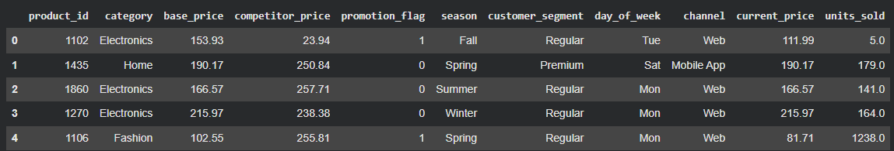
Data Overview & Preparation
Transaction-level e-commerce data
Key variables:
Price, Units Sold, Category
Promotions, Competitor Price
Data cleaning:
Missing values handled
Outliers reviewed
Feature engineering applied

Slide 5
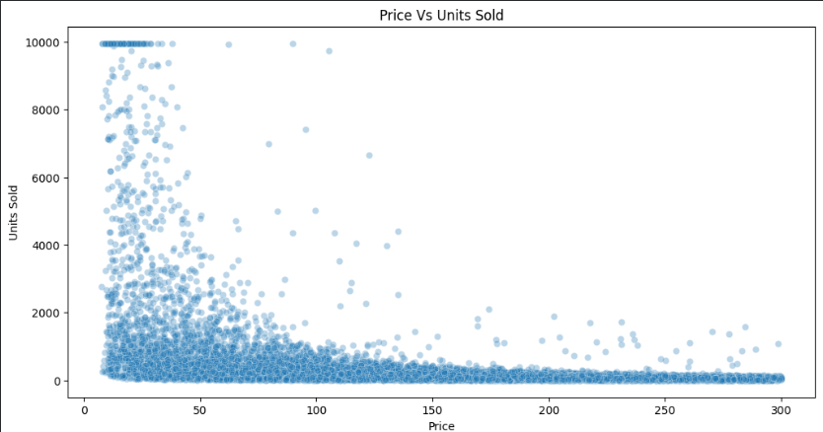
Price Elasticity & Demand Behavior Analysis
Key findings:
Demand decreases as price increases (negative elasticity)
Elasticity varies by category
Promotions significantly increase price sensitivity
Competitive pricing strongly impacts demand

Slide 6
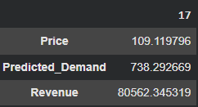
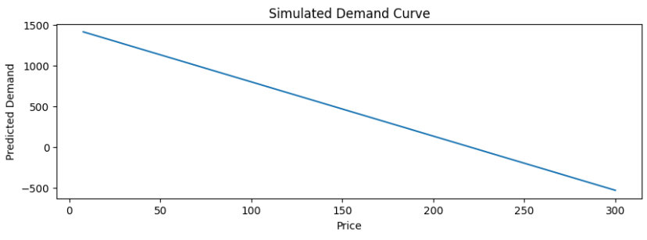
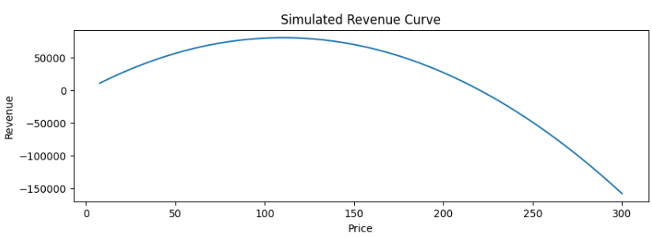
Demand Modeling & Revenue Simulation
Approach:
Linear regression used to model price–demand relationship
Demand simulated across a range of prices
Revenue curves generated to identify optimal price points
Key Insight:
Revenue does not increase linearly with price
Each category has a revenue-maximizing price

Slide 7
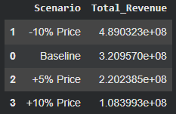
Pricing Scenario Simulation
Simulated scenarios:
Baseline pricing
−10% discount
+5% price increase
+10% price increase
Findings:
Discounts generate the highest theoretical revenue
Price increases reduce demand sharply

Slide 8
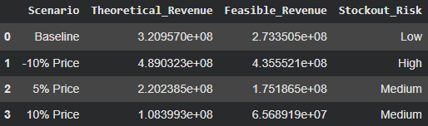
Inventory-Aware Revenue Feasibility
Key logic:
You can only sell what you have
Demand exceeding inventory results in lost sales
What we did:
Simulated inventory availability
Calculated fulfilled (feasible) demand
Compared theoretical vs feasible revenue

Slide 9
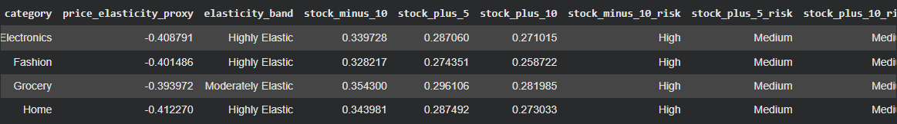
Elasticity & Inventory Risk Segmentation
Products segmented by:
Price elasticity (High / Moderate)
Stockout risk (Low / Medium / High)
Key insight:
Highly elastic categories benefit from discounts
But also face high stockout risk
Pricing decisions must consider both elasticity and supply risk

Slide 10

Business Recommendations
Pricing Strategy
Avoid aggressive discounts without inventory buildup
Prefer moderate price changes with stable fulfillment
Inventory Coordination
Increase stock before promotions
Align pricing with replenishment cycles
Strategic Insight
Optimize realized revenue, not theoretical demand

Slide 11

Interactive Dashboard & Deployment
Streamlit dashboard built for decision-makers
Features:
KPI tracking
Scenario comparison
Inventory risk alerts
Deployed online for real-time access
Live Dashboard Link: Pricing & Inventory Optimization · Streamlit

Slide 12
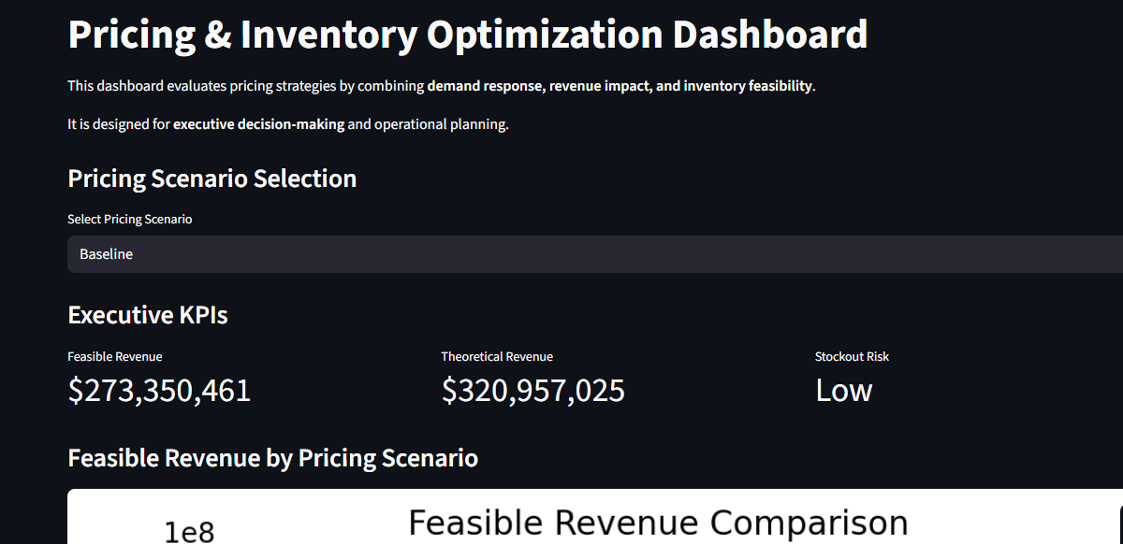
Project Impact & Skills Demonstrated
Business Impact
Reduced pricing risk
Improved revenue realization
Inventory-aligned decision making
Skills Demonstrated
Data Analysis
Econometrics & Pricing
Forecasting
Scenario Simulation
Business Communication
Deployment
🚀 Future Enhancements
Non-linear demand models
Dynamic pricing optimization
Supply-chain lead-time integration
SHAP-based explainability
Automated price recommendations

